Slide 1
Lecture 24: Definitiveness of (Ethical) Human Conduct

Slide 2


Slide 3
UHV-II: A Foundation Course in Universal Human Values and Ethics (aka. Understanding Harmony)
LTPC 3-1-0-3 Mandatory Credit Course in 3rd/4th Semester 28 lectures and 14 tutorials
Module 5 – Implications of the Holistic Understanding – a Look at Professional Ethics (6 lectures and 3 tutorials for practice sessions)
Lecture 23: Natural Acceptance of Human Values
Lecture 24: Definitiveness of (Ethical) Human Conduct
Tutorial 12: Practice Session PS12 Exploring Ethical Human Conduct
Lecture 25: A Basis for Humanistic Education, Humanistic Constitution and Universal Human Order
Lecture 26: Competence in Professional Ethics
Tutorial 13: Practice Session PS13 Exploring Humanistic Models in Education
Lecture 27: Holistic Technologies, Production Systems and Management Models-Typical Case Studies
Lecture 28: Strategies for Transition towards Value-based Life and Profession
Tutorial 14: Practice Session PS14 Exploring Steps of Transition towards Universal Human Order

Slide 4
Placement of Module 5
Understanding Harmony
Modules 1-4
Feeling of relationship
mutual fulfilment, values
Thought Principles and
Guidelines for
Ethical Human Conduct
Module 5
Behaviour Ethical behaviour
Work and Ethical work (examples and
Participation Ethical participation case studies…)
Outcome Continuous happiness at individual level and
expected Fulfilment of human goal at societal level

Slide 5
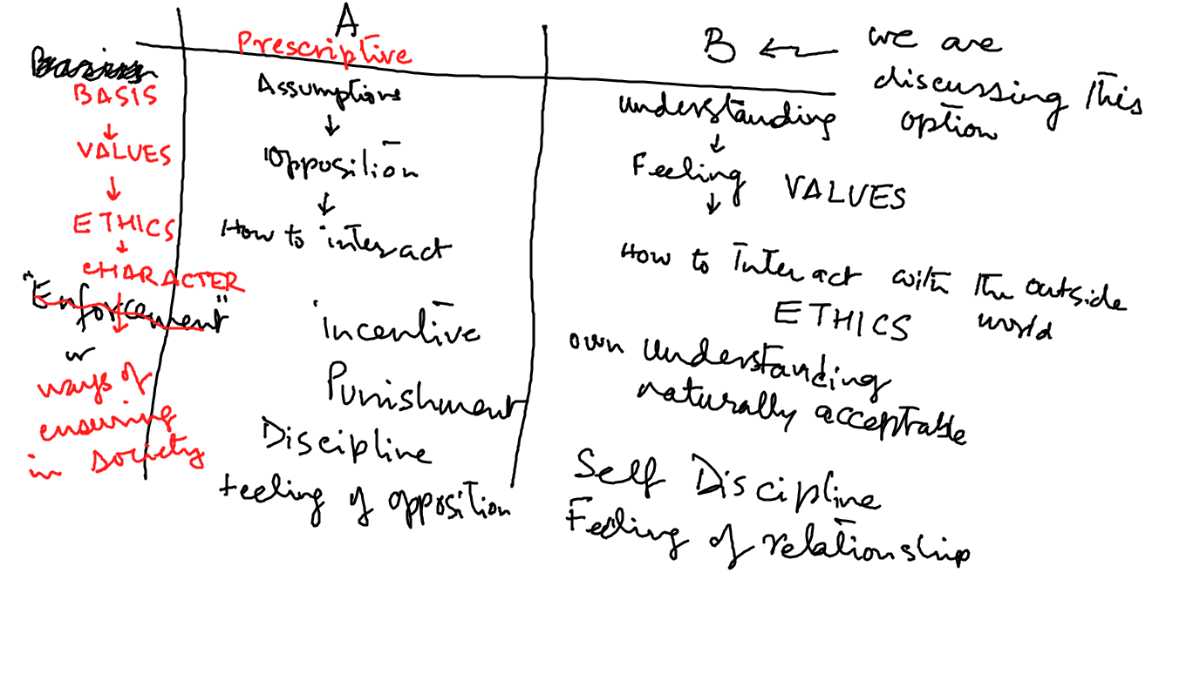

Slide 6
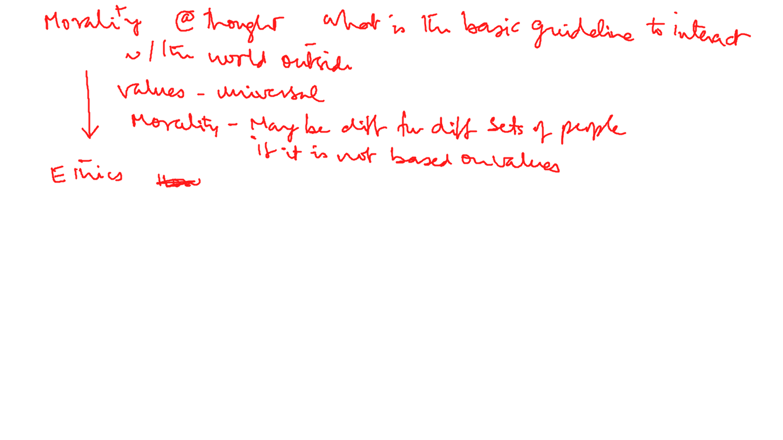

Slide 7
Recap
In the previous lecture, we saw how value-based living naturally emerges out of right understanding.
In this lecture, we will learn about ethical human conduct naturally emerging out of right understanding, and see how it is definite.

Slide 8
Definitiveness of Ethical Human Conduct
Harmony at Different Levels | Expression & Achievement
Harmony at the level of Self | Happiness
Harmony of the Self with the Body | Feeling of self-regulation at the level of Self and Health at the level of body
Harmony in the family, in human-human relationship | Mutual happiness, trust, fearlessness… justice
Harmony with rest of nature | Mutual prosperity – prosperity in human being and preservation of rest of nature
Harmony with the whole of nature/ existence | Co-existence (mutual fulfilment) with entire Nature

Slide 9
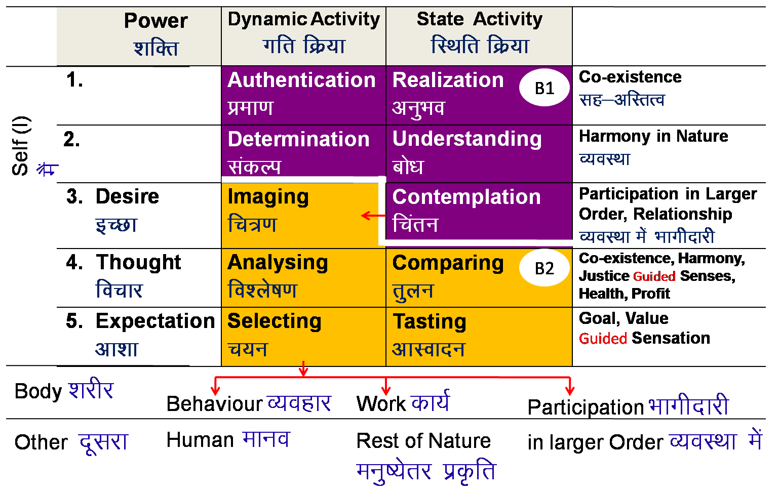
Definitiveness of Ethical Human Conduct- View 1
vuqHko& Lo;a esa
Realization- Within
Mutual Happiness
mHk; lq[k
Mutual Prosperity
mHk; le`f)
Fulfillment of Human Goal
Ekkuo y{; dh iwfrZ
Human Tradition
ekuoh; ijaijk
Undivided Human Society
v[k.M ekuoh; lekt
vfHkO;fDr& ckgj
Expression- Outside
Universal Human Order
lkoZHkkSe ekuoh; O;oLFkk

Slide 10
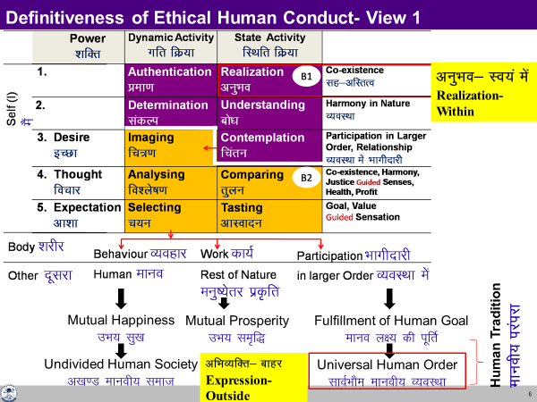
Definitiveness of Ethical Human Conduct- View 1
As described in the last diagram,
It all starts with
realisation of co-existence and completes with
participation in the universal human order with
right feelings, right thought and
mutually fulfilling behaviour & work in between *
* We have already discussed this in quite details in previous lectures, hence we will not take up the details here.

Slide 11
Definitiveness of Ethical Human Conduct- View 2
The ethical human conduct can be further grasped in terms of
values,
policy and
character

Slide 12
Values, Policy and Character
Human Values – Understanding "What to do as a human being" and "What not to do as a human being"
Policy – Detail, thought of "how to do" Human Constitution
Includes plan, program, implementation, results, evaluation
    Policy for enrichment of Self (I), Body, Physical Facility (Human Economics)
    Policy for protection of Self (I), Body, Physical Facility (Human Politics)
    Policy for right utilisation of Self (I), Body, Physical Facility (Human Sociology)
Character –
    Compassionate behaviour, work & participation in larger order on the basis of human values
    Rightfully acquired wealth
    Chastity in conjugal relationship

Slide 13
Values
Understanding "What to do as a human being" and "What not to do as a human being" *1
Understanding of role of Human Being in Existence
Once we have the right understanding (of relationship, harmony and co-existence), we are able to see our natural participation or values at all levels of being – from individual, to family, society, nature/existence.
This participation or the human values are definite and form the basis of our ethical human conduct.
*1 To be able to distinguish between “source of continuous happiness and temporary excitement”…

Slide 14
Values
Value of a unit is its participation in the larger order
(larger order = larger, harmonious system)
e.g. Value of pen is that it helps to write
(participation in education)
Value of water is that it quenches thirst
(participation in health)
Similarly,
Your value wrt to yourself is your participation in the harmony within you (in the Self).
Value of your body is participation in your external activities as a harmonious human being.
Your value in the family is your participation in the harmony in the family.
Your value in the society is your participation in the harmony in the society.
Your value in the nature is your participation in the harmony in the nature.
Your value in the existence is your participation in the co-existence.
In this course, we tried to explore the universal values of a human being.

Slide 15
Sum Up
Level. Name | Relationship / Potential- Values | Details
4b. Existence | Co-existence | Co-existence Potential for human being to realise
4a. Nature | Mutual Fulfillment | Harmony, Relationship Potential for human being to be in harmony
3. Society | Right Understanding, Prosperity, Fearlessness (Trust), Co-existence | Human-Nature relationship Potential, through participation of individuals and families in various societal systems
2. Family | Feeling of co-existence Trust, Respect … Love | Human-Human relationship Potential for right feeling in the Self – mutual happiness
1b. Individual Human Being | Co-existence of Self and Body | Self-Body relationship Potential for feeling of self-regulation
1a. Self (I) | Continuous happiness = happiness, peace, satisfaction, bliss | Will to live with continuous happiness Potential for right understanding, right feeling and right thought → mutually fulfilling behavior and work
Universal Values

Slide 16
Policy
Thought of how to express (live with) Human Values
Detail, thought of "how to do" Human Constitution
Includes plan, program, implementation, results, evaluation
Policy for enrichment of Self (I), Body, Physical Facility (Human Economics)
Policy for protection of Self (I), Body, Physical Facility (Human Politics)
Policy for right utilisation of Self (I), Body, Physical Facility (Human Sociology)
Priority
Right utilization
Protection
Enrichment

Slide 17
Policy – Detail, thought of "how to do"–Human Constitution
Includes plan, program, implementation, results, evaluation
    Policy for enrichment of Self (I), Body, Physical Facility (Human Economics)
    Policy for protection of Self (I), Body, Physical Facility (Human Politics)
    Policy for right utilisation of Self (I), Body, Physical Facility (Human Sociology)
Policy for right utilisation (priority1)
Of Self (I) Policy for investing the Self (I) for understanding and living in harmony at all levels
Of Body Policy to ensure that the body is used for ensuring right understanding and right feeling in the self as well as its authentication in living, including behavior, work and participation in larger order
Of PF Policy to ensure the use of PF for nurturing, protection and right utilisation of the body. Policy for right utilisation of physical facility for relationship and societal order

Slide 18
Policy for Protection (priority 2)
For Self (I) Policy for ensuring conducive environment for the Self (I) for understanding and living in harmony at all levels and protecing from unfavourable environment
For Body Policy for ensuring shelter, clothes…
For PF Policy for preservation, proper storage…
Policy for Enrichment (priority 3)
For Self (I) Policy for education-sanskar, adult education, other efforts (such as development of sanskar through societal functions, ceremonies…), for understanding and living in harmony at all levels in the Self (I)
For Body Policy for intake-lifestyle to ensure health of body
For PF Policy for production with right process & right skills

Slide 19
Character
Expression of Human Values in Behavior, Work and Participation in the Larger Order
This can be understood in terms of the following:
  Rightful acquisition and utilization of wealth – by way of labour, using cyclic and mutually enriching production processes.
  Compassionate behaviour, work & participation in larger order on the basis of human values
    Behaviour– ensuring justice, mutual happiness (while filling the gaps created in ignorance)
    Work – ensuring preservation, mutual prosperity (while filling the gaps created in ignorance)
    Participation in larger order- leading to fulfilment of the comprehensive human goal
    (while filling the gaps created in ignorance)
  Chastity in conjugal relationship i.e. chastity in husband-wife relationship.

Slide 20
Rightfully Acquired Wealth
Production- through labour on rest of nature (using cyclic and mutually enriching production processes) or physical facility obtained in exchange of service
Gift – wealth shared willingly / happily (with the feeling of relationship) from one’s rightfully acquired wealth on various occasions like festivals (ex. gift in relationship)
Award – physical facility / wealth given with joy in a function to recognise one’s contribution to society (participation in the societal order) and for motivating others

Slide 21
Ethical Human Conduct
Further
‘Ethical conduct’ implies that it is naturally acceptable to me and does not give rise to conflict within
‘Ethical conduct’ implies that it is in consonance with the right understanding of the reality – the underlying harmony at all levels.
‘Ethical conduct’ implies that it leads to mutual fulfilment with other people and mutual enrichment with rest of nature
Thus, the ‘ethical conduct’ is self-satisfying, people-friendly and eco-friendly for all time, place and individual.

Slide 22
Key Takeaways
Ethical human conduct emerging out of right understanding leads to harmony at all levels of being – from oneself to family, society and nature/ existence.
It is definite for all time, place and individual.

Slide 24
Tendency of Human Living with Human Consciousness
= Natural Characteristic of Human Being with Human Consciousness
Perseverance
Brevity
Generosity
Kindness Providing means to one who has the ability but not the
means.
Beneficience Helping the other to develop the competence to
utilise the means they already have.
Compassion Helping the other unconditionally, to develop the
competence as well as the means, to fulfill his needs when he does not have either the ability nor the means.

